Slide 1
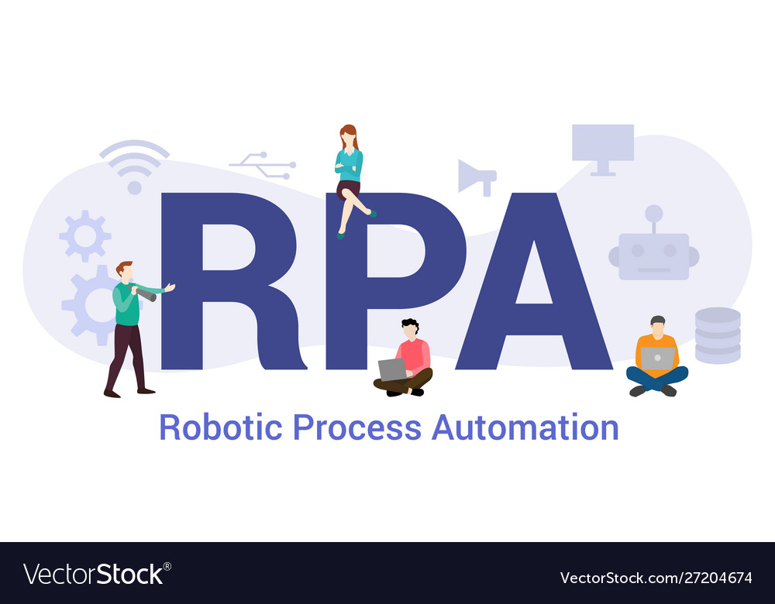
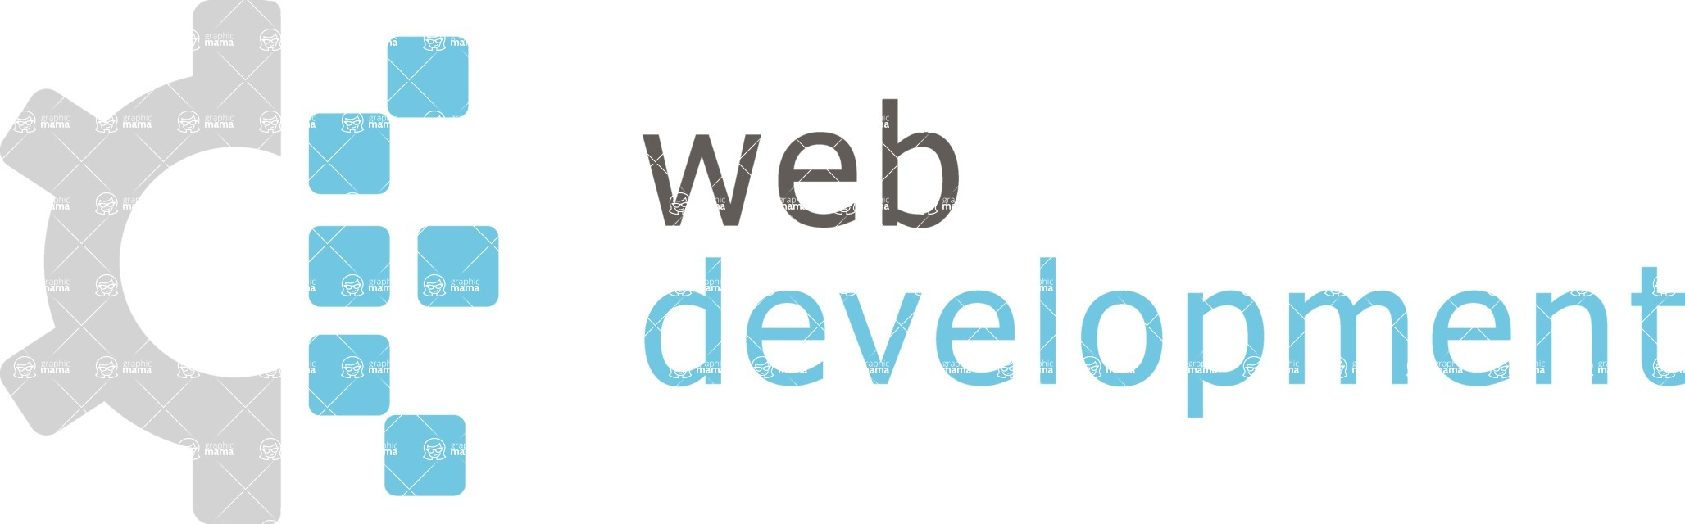

A PRACTICAL GUIDE FOR RPA AND WEB DEVELOPMENT

Slide 2
Front-end 🡪 Front facing website or app UI
HTML, CSS, SASS, JQuery, JavaScript, Typescript, JS framework, DOM, HTTP at iba pa
Back-end 🡪 Server API’s, data, tasks
Full stack 🡪 Combined of front-end and back-end
RPA 🡪 Blue prism, UIPath and automation everywhere

Slide 3
WEB DEVELOPMENT
Web development is the work involved in developing a website for the Internet (World Wide Web) or an intranet (a private network).

Slide 4
SET A GOALS
To be come professional dev at a company (Large & Small)
Freelancer/ Consultant or create your own business
Build your own apps
Just a hobby

Slide 5
BASIC TOOLS
Computer & OS
- MacOS, Windows, Linux
Text Editor
- VS Code, Vim, Atom, Sublime Text
Web Browser
- Chrome, Firefox, Safari, Edge, Brave
Terminal
- Default, Hyper, PowerShell, Git Bash
Design Software
- Adobe XD, Photoshop, Sketch, Figma

Slide 6
HTML,CSS
HTML 5 Page Structure & Semantic Tags
Basic CSS Styling
Positioning
Alignment (Flexbox & CSS Grid)
Transitions & Animation
Responsive Design/ Media Queries

Slide 7
SASS
CSS preprocessor that gives you more functionality in your styling.
Sass offers thing like variables, mixins, functions, nesting , etc
SASS is optional , it Is something I suggest learning. It is easy to pickup
And you will most likely run into it at some point.

Slide 8
CSS, UI FRAMEWORKS
Tailwind CSS 🡪 Utility-firsts framework
Bootstrap 🡪 Popular framework (Bootstrap5 released)
Material 🡪 Based on Material
Bulma 🡪 Modular & lightweight

Slide 9
UI DESIGN
Color & Contrast 🡪 Make sure text is readable
White Space 🡪 Spacing between elements
Scale 🡪 Sizing relative to other elements
Visual Hierarchy 🡪 Arrange in order of importance
Typography 🡪 Text typefaces, sizing, etc

Slide 10
JAVASCRIPT
Basics 🡪 Variable, arrays, functions, loops, etc
DOM & Styling 🡪 Selecting and manipulating elements
Array Method 🡪 Foreach, map, filter, reduce, etc
JSON 🡪 JavaScript Object Notation
HTTPS Request 🡪 Fetch API –Get, Post, Put, Delete

Slide 11
OTHER TOOLS
Version Control 🡪 Git, Subversion
Repo Manager 🡪 Github, Bitbucker, Gitlab
Package Manager 🡪 NPM, Yarn
Browser Developer Tools (Console, Network, Storage, etc)

Slide 12
What Next?

Slide 13
SERVER SIDE
Node.js
Deno
Python
C#
GoLang (is created language from google)
Ruby
PHP
Java
Kotlin
The backend/server side focuses on data, modeling and HTTP request/Response. A Server side language is needed for back-end or fullstack developer

Slide 14
SERVER SIDE FRAMEWORKS
Node.js 🡪 Express, Koa, Nest, Loopback
Python 🡪 Django, Flask
C# 🡪 ASP.NET
Ruby 🡪 Ruby on Rails, Sinatra
PHP 🡪 Laravel, Symfony, Slim
Java 🡪 Spring MVC
Kotlin 🡪 Javalin, Ktor
A framework is usually used in back-end web development

Slide 15
DATABASES
PostgresSQL
MongoDB
MySQL
MS SQL Server
Firebase
ElasticSearch

Slide 16
FULL STACK DEVELOPER
Comfortable with both building Front-end Uls and servers
Know a server side language/technology
Can work with & structure databases, working with ORMs/ODMs
Understand HTTP & Create RESTful APIs
Can successfully deploy full stack projects
Very Comfortable with the terminal

Slide 17
TESTING
Unit Testing 🡪 Individual units like functions or classess
Integrations Tests 🡪 Modules tested as a group
End-to-end Tests 🡪 Test workflow from start to finish Testing is a great thing to have in your toolkit. It helps prevent
Problems before they happen.

Slide 18
ROBOTIC PROCESS AUTOMATION
Robotic 🡪 When a machine mimics human action, it Is called Robotic
Process 🡪 A sequence of steps to perform a task, is called a process
Automation 🡪 Any task when done without human intervention, is termed
As Automatic

Slide 19
WHY DO WE NEED RPA?
McKinsey&Company
- For them 22 percent of IT jobs can be replaced by Robotic Process Automation in the coming years
Forrester
- For them Market will grow more by 2.1 Billion Dollars by the year 2022
Benefits of RPA
- Save money
- Helps reduce human interface in repetitive tasks
- No coding required

Slide 20


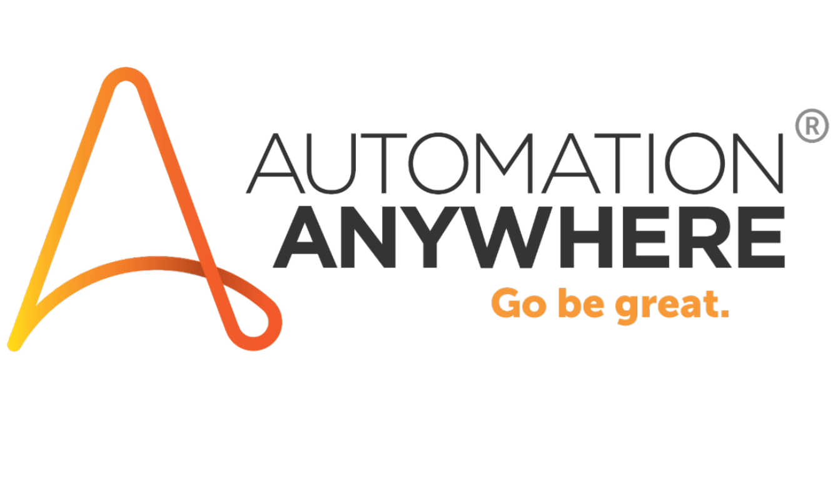
RPA TOOLS

Slide 21
INTRODUCTION TO UI PATH
UI path is a leading Robot Process Automation vendor providing a complete software platform to help organizations efficiently automate business process. UI Path also offers a community edition to people who
want to learn and implement RPA

Slide 22
INSTALLING UIPATH
Go to the following link bellow
https://www.uipath.com/developers/community-edition-download
Fill out the information in the form on this website
You will receive an email from Uipath, once you entered all the information they need
Once downloaded, fill in the steps on the screen to successfully completed
installation

Slide 23
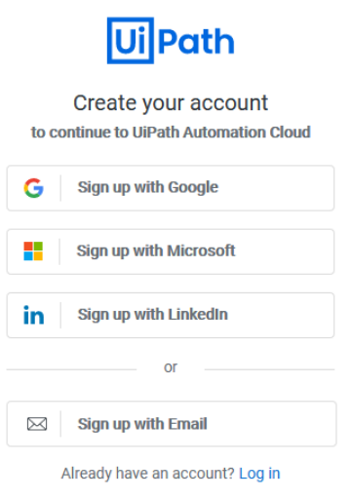
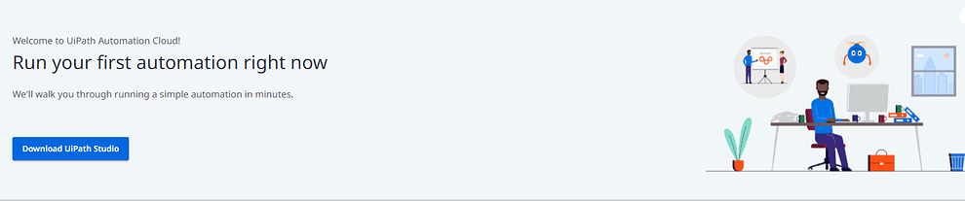
Register your new UiPath account
Download your Studio Community edition

Slide 24
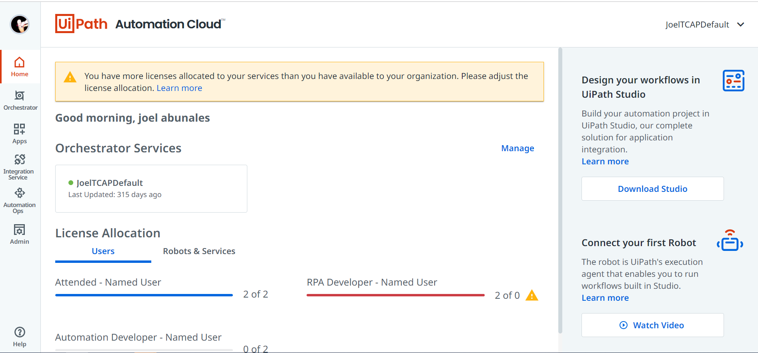
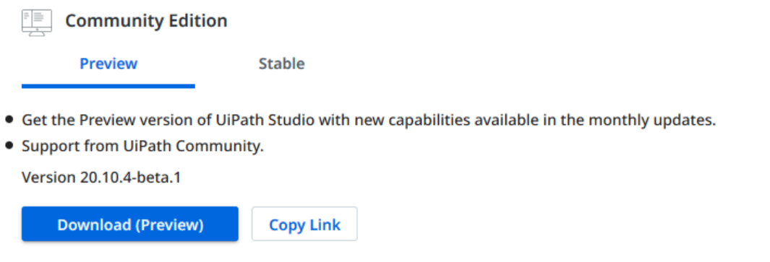
Dashboard
Click on the Download button for the Community Edition .exe installer:

Slide 25
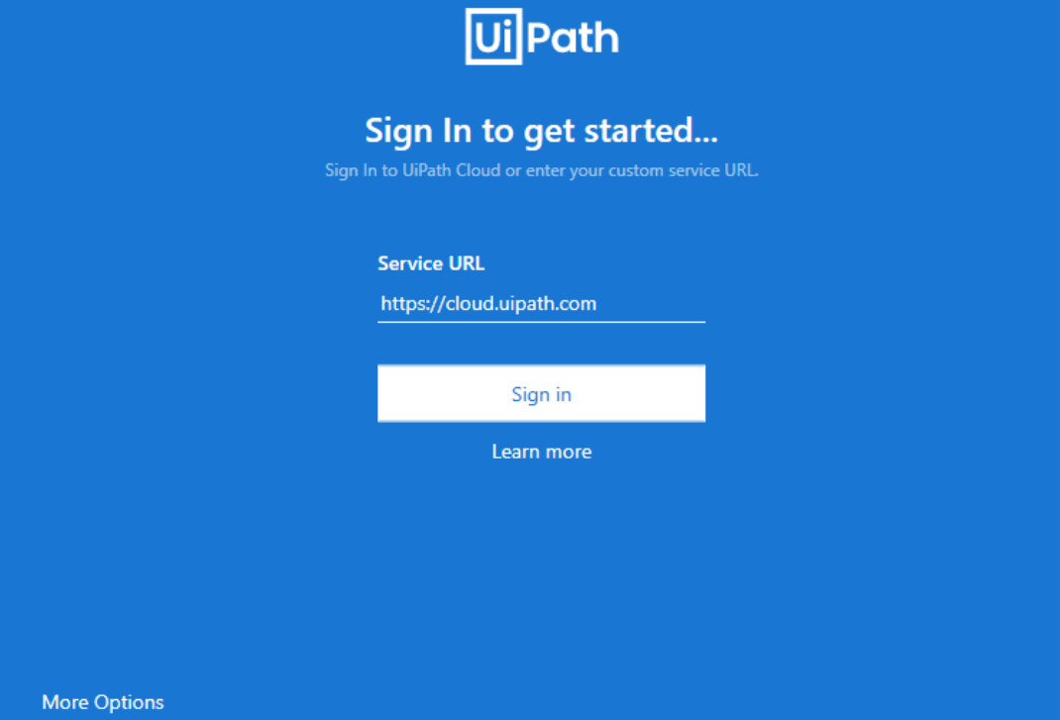
Connect your UiPath Robot to Orchestrator via your UiPath Assistant
If you have never worked with UiPath before

Slide 26
END

